Slide 1
Practicing Machine Learning
Modern AI Pro: Level 1
Balaji Viswanathan

Slide 2
Key goals.
Binary Classification
Encoding data
Dealing with Ethics
Convert non-numeric data with Label Encoder
Predict the income class of a person.
Responsible AI
Linear Regression
Train Test Split
Visualize data
Predict home prices
Splitting data into train and test.
With Histograms and Heatmaps

Slide 3
How will you use this?
Responsibly implement machine learning projects within your organization dealing with numeric data and making decisions from them.

Slide 4

LLMs as conductors.

Slide 5
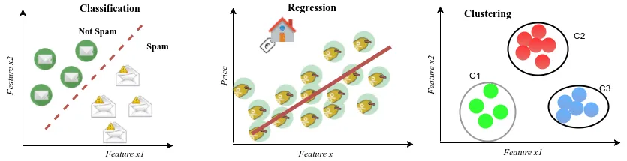
Classes of ML Problems.

Slide 6
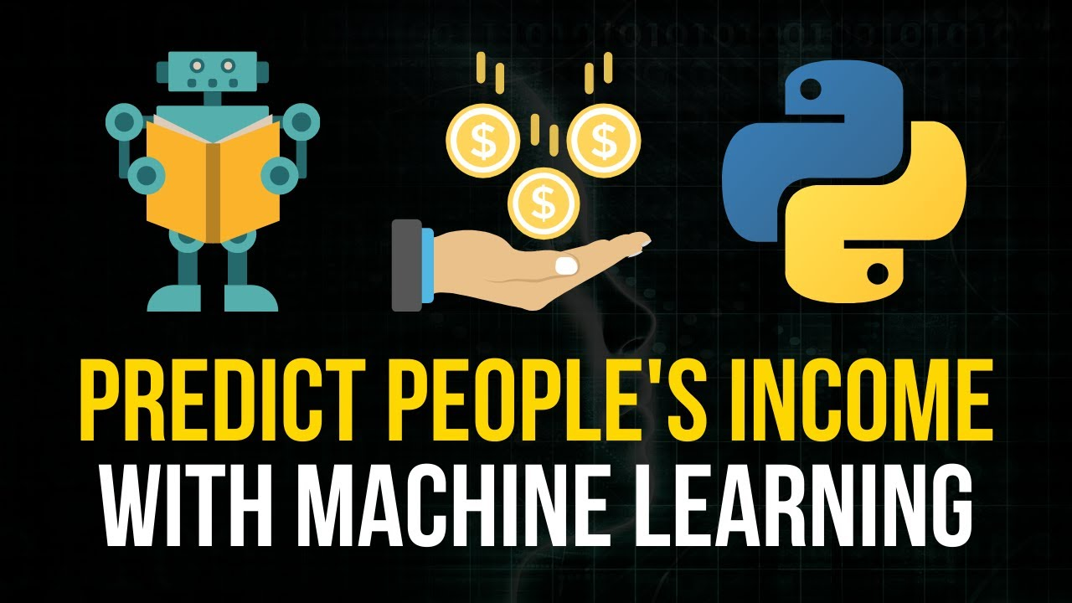

Slide 7
Basic ML setup
Visualize Data
Load data
Encode non- numeric data
Train-Test Split
Train

Slide 8
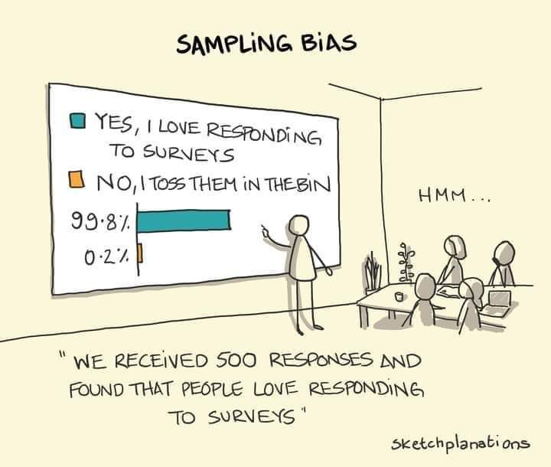
Ethics in AI
Sampling bias
Misinterpretation of data
Fairness
Accountability

Slide 9
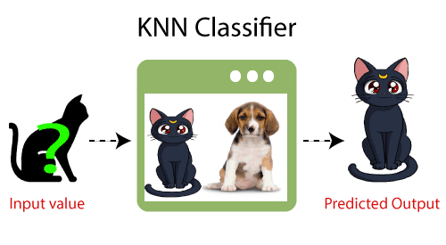

Slide 10
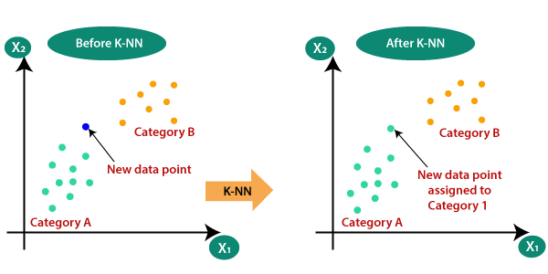

Slide 11
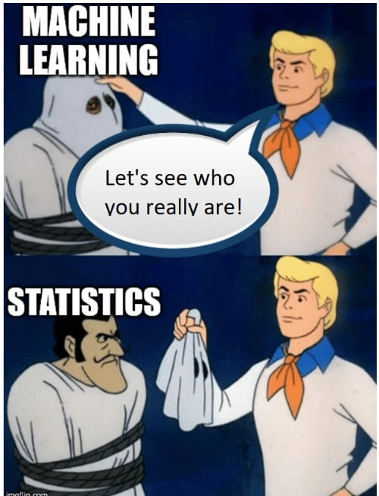

Slide 12
